Slide 1
Ram Prasad
Paris Olympic 2024 Dashboard using Power BI
Introduction
Objective:
The primary objective of this project was to create an interactive and comprehensive dashboard that visualizes data from the Paris Olympic 2024. This dashboard aims to provide stakeholders with actionable insights into athlete performances, country rankings, and historical trends, enabling data-driven decision-making.
Scope:
The project encompasses the visualization of key metrics such as total medals won, athlete demographics, country performance, and a comparison with historical data from previous Olympics. While the focus is on the 2024 Paris Olympics, the dashboard also includes historical comparisons to provide a deeper context.

Slide 2
Data Source and Tools
Data Source:
The dataset was sourced from Kaggle, a widely recognized platform for public datasets. It included detailed information on the athletes, their performances, and the countries they represent in the Paris Olympic 2024. I used Python scripts to import this dataset into Power BI, which allowed for seamless integration and further data processing.
Tools and Technologies:
Power BI was the primary tool used for creating the dashboard due to its powerful data visualization capabilities and ease of use. I also employed Python for data import and initial preprocessing to ensure the data was in a suitable format for analysis. DAX (Data Analysis Expressions) was utilized for creating custom calculations within Power BI, enabling more sophisticated and tailored analysis.

Slide 3
Data Preparation
Data Cleaning:
I began with data cleaning to ensure accuracy and consistency. This involved identifying and removing duplicate records, addressing missing data through appropriate methods like imputation or exclusion, and standardizing formats such as dates and text fields. These steps were crucial to avoid errors in analysis and to ensure reliable results.
Data Processing:
Once the data was cleaned, I performed various transformations to make it analysis-ready. This included creating calculated columns for additional metrics, normalizing data where necessary, and aggregating data at different levels to enable comprehensive analysis. These processes were essential to prepare the data for the in-depth analysis that followed in Power BI.

Slide 4
Dashboard Overview
Dashboard Structure:
The dashboard is structured into five main sections:
Home: Serves as the central hub, providing an overview and links to other dashboards.
Overview: Displays key metrics such as total medals won, number of participating countries, and total athletes.
Athletes: Focuses on athlete demographics, performance by gender and age group, and medal counts.
Country: Analyzes country performance, comparing top-performing nations and providing insights into their contributions.
Historical: Provides a longitudinal view, comparing the performance of countries and athletes across different Olympic games.
Design Philosophy:
I prioritized a user-centric design to ensure that the dashboard is intuitive and easy to navigate. The visual elements were carefully chosen to make complex data accessible and to highlight key insights at a glance. Each dashboard was designed with the end-user in mind, ensuring that it is both informative and visually appealing.

Slide 5
Dashboard Features
Interactive Elements:
I incorporated several interactive elements to enhance user engagement:
Slicers: Allow users to filter the data by various dimensions such as country and year, enabling a customized view of the data.
KPIs: Display critical metrics prominently, such as total gold, silver and bronze medals won by athletes and number of countries, teams, and athletes participated in olympic, providing a quick overview of key statistics.
Selection Pane: Used to manage the visibility of different objects, ensuring a clean and organized dashboard layout.
Navigator: Facilitates seamless transitions between different sections of the dashboard, improving the overall user experience.
Custom Calculations:
I leveraged DAX to create custom calculated columns and measures that were essential for in-depth analysis. For example, I created measures to calculate the total number of medals by year and gender, the performance of countries over time, and comparisons between different demographics. These calculations added significant value to the dashboard, allowing for more granular insights.

Slide 6
Overview Dashboard
Key Highlights:
The Overview dashboard provides a high-level summary of the Paris Olympic 2024. It includes total medals won by athletes, broken down into gold, silver, and bronze categories. Additionally, it shows the distribution of medals by country and gender, and provides overall metrics such as the total number of participating countries, teams, and athletes.
Visualizations:
I used a variety of visual tools to represent the data effectively. Bar charts were employed to show the distribution of medals, while bar charts provided a clear comparison between countries. KPIs were strategically placed to highlight key metrics, making the dashboard both informative and easy to interpret.

Slide 7
Athletes Dashboard
Athlete Insights:
The Athletes dashboard focuses on demographic and performance data. It categorizes athletes by age and gender, providing insights into who is participating in the Paris Olympic 2024. Additionally, it highlights medal distribution by gender and compares athlete participation across different countries. By connecting athlete participation data with medal counts, the dashboard offers a comprehensive view of athlete performance across the board.
Visualizations:
I utilized column charts and donut charts to represent the number of athletes in different age groups and gender, and bar charts to track total athletes and medals won by each countries and also to track total athletes gender wise for each countries . These visualizations were chosen for their clarity and ability to convey complex data in an understandable way.

Slide 8
Country Dashboard
Country Performance:
The Country dashboard is designed to analyze the performance of different countries in the Paris Olympic 2024. It identifies the top-performing countries based on total medals won and provides participation metrics, such as the number of countries, teams, and athletes involved. Comparative analyses are also included to show how nations performed relative to each other.
Visualizations:
I used stacked bar charts to show the distribution of medals among the top-performing countries and ranked lists to display countries in order of their success. These visual tools were chosen to make comparisons straightforward and to highlight the achievements of different nations.

Slide 9
Historical Dashboard
Historical Trends:
The Historical dashboard provides a longitudinal analysis of Olympic performance, showing the distribution of medals across different games and highlighting trends over time. It includes an analysis of how countries have performed historically, showing whether they have improved, maintained, or declined in their medal counts.
Visualizations:
I employed line charts to track the performance of countries over time, illustrating trends in medal counts. This choice of visualization was crucial for showing how countries' performances have evolved across different Olympic Games, making it easy to spot patterns and trends.

Slide 10
Technical Challenges and Solutions
Challenges:
During the project, I faced several challenges, including complexities in merging data from multiple sources and ensuring consistency across the dataset. Creating accurate DAX queries for custom calculations also required a deep understanding of the data and the Power BI environment. Additionally, designing a user-friendly interface that accommodates multiple dashboards was challenging but essential for ensuring a positive user experience.
Solutions:
To overcome these challenges, I used Python scripts to streamline the data import. and clean the data, ensuring that the data was consistent and reliable. I also spent considerable time in writing DAX queries. Through iterative design, I refined the user interface, making it more intuitive and accessible. These solutions were critical in delivering a functional and user-friendly dashboard.

Slide 11
Project Outcome
Results:
The Paris Olympic 2024 dashboard I developed successfully provides stakeholders with valuable insights into athlete performance, country rankings, and historical trends. The dashboard's interactive elements and clear visualizations have been well-received, making it a useful tool for analysis and decision-making. The project also showcased my ability to handle large datasets, perform in-depth analysis, and create user-friendly visualizations.
Learning and Takeaways
Skills Gained:
This project significantly enhanced my skills in Power BI, particularly in creating effective data visualizations and dashboards. I also improved my proficiency in DAX, allowing me to perform complex calculations within Power BI. Overall, this project strengthened my data analysis capabilities, particularly in handling and analyzing large datasets.
Future Applications:
The skills and knowledge I gained from this project are directly applicable to future data analysis and visualization tasks. I am now better equipped to tackle similar challenges in other projects, whether they involve sports data or other domains. This experience will also help me contribute more effectively to data-driven decision-making processes in any organization.

Slide 12
Conclusion
Summary:
In conclusion, the Paris Olympic 2024 dashboard I developed provides a comprehensive and interactive platform for analyzing key metrics related to the Olympic Games. The dashboard offers valuable insights into athlete performance, country rankings, and historical trends, making it a powerful tool for stakeholders. This project allowed me to enhance my skills in Power BI, DAX, and data analysis, and has prepared me for future challenges in the field.
Next Steps:
Potential future improvements include incorporating additional data sources to provide even richer insights, enhancing the dashboard's interactivity, and expanding its scope to cover other sporting events. Continuous improvement and adaptation will ensure the dashboard remains a valuable tool for users.
GitHub Link: https://github.com/ram0109/Paris-Olympic-2024-Dashboard
Thank you for your attention. I’m happy to answer any questions or hear any feedback you may have.
Ram Prasad

Slide 13


Slide 14
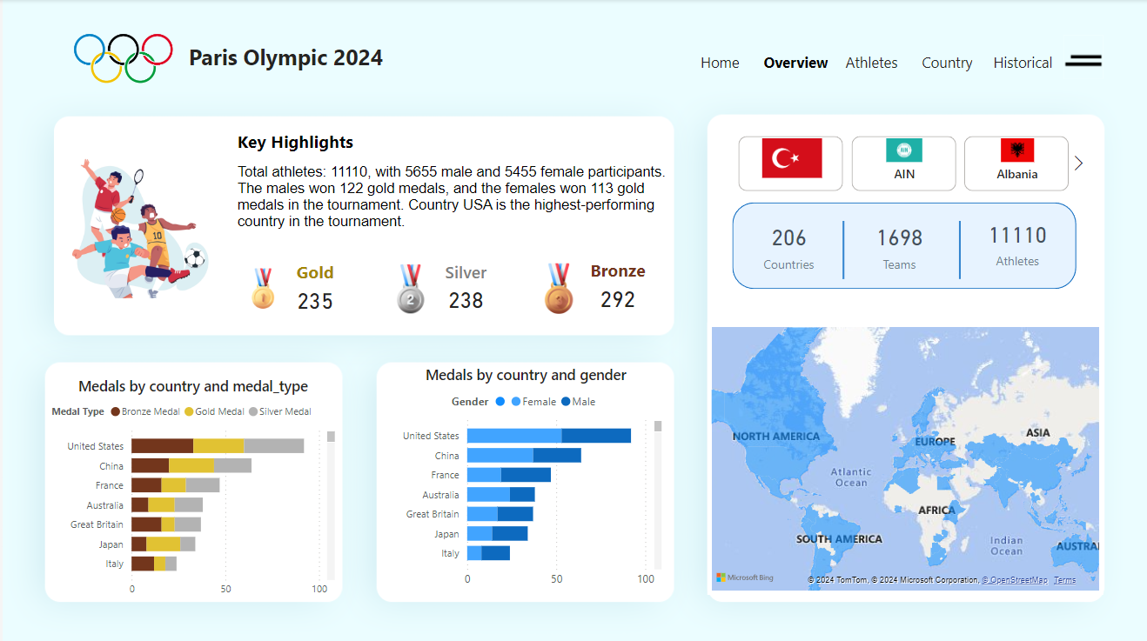

Slide 15
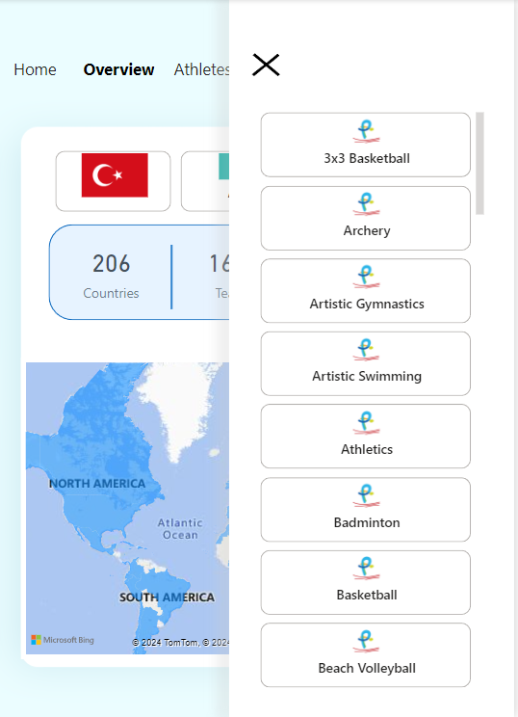

Slide 16
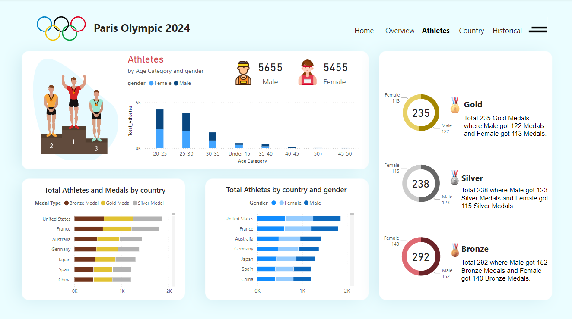

Slide 17
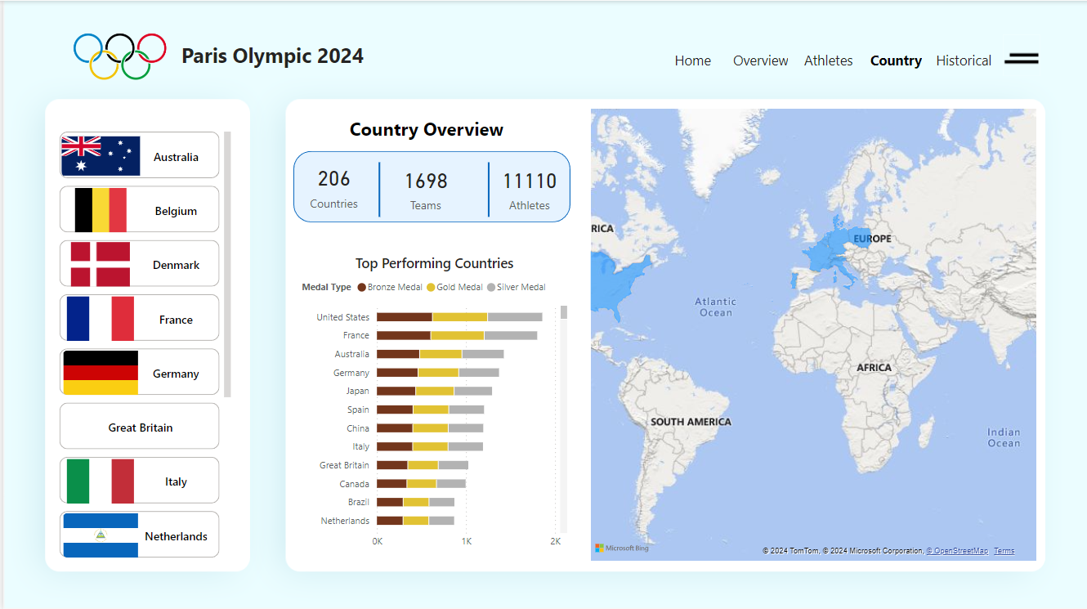

Slide 18
